Slide 1
The Impact of Community Codes in Astrophysics
Anshu Dubey
With slides from
Brian O’Shea (Enzo)
Matt Turk (Enzo and yt)
August 13, 2014

Slide 2
The Astrophysics Community
Had an early culture of releasing research software starting in the early eighties
N-body codes for many-body gravitational interactions
Nbody_{x} went from Nbody₁ to Nbody₆
Barnes and Hut tree code
Hydrodymanics with ZEUS-2D, and later ZEUS-3D
SPH codes such as Hydra and Gadget
Over time public codes became more sophisticated
AMR appeared in FLASH is early 2000
Shock-capturing MHD and radiation hydro also started to appear

Slide 3
The Astrophysics Community
The tradition has continued with many more codes appearing over the years
Some codes are extensible
Capabilities added over time
A comprehensive list can be found at the Astrophysics Source Code Library
http://ascl.net/code/all/page/4/limit/100/order/title/listmode/full
Not only Astro codes, but all codes useful to Astro

Slide 4
The Astrophysics Community
Most codes started as research software and became public later
Were developed as closed and used by the core group for years before being released (Enzo)
Others were developed with the intent of being made public as soon as possible (FLASH)
With the arrival of “yt” there is yet another paradigm shift
An analysis and visualization packaged developed by the astrophysicists for astrophysicists
Building the community and development by the community from the very beginning

Slide 5
Why did Community Codes Flourish in Astrophysics
Why do some communities adopt the open source model while others do not ?

Slide 6
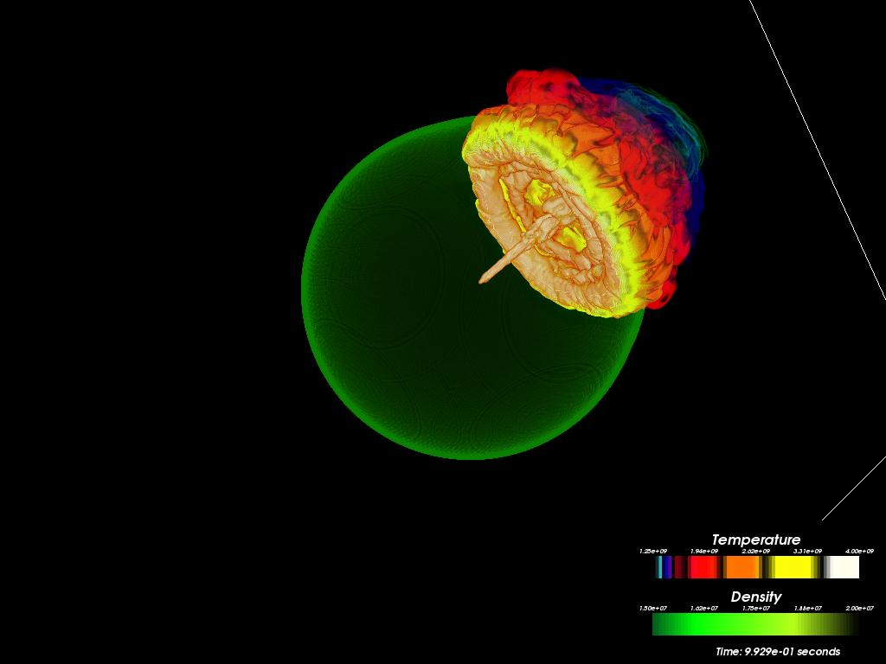
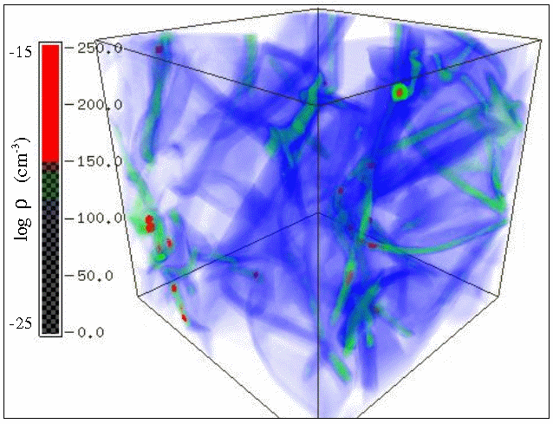
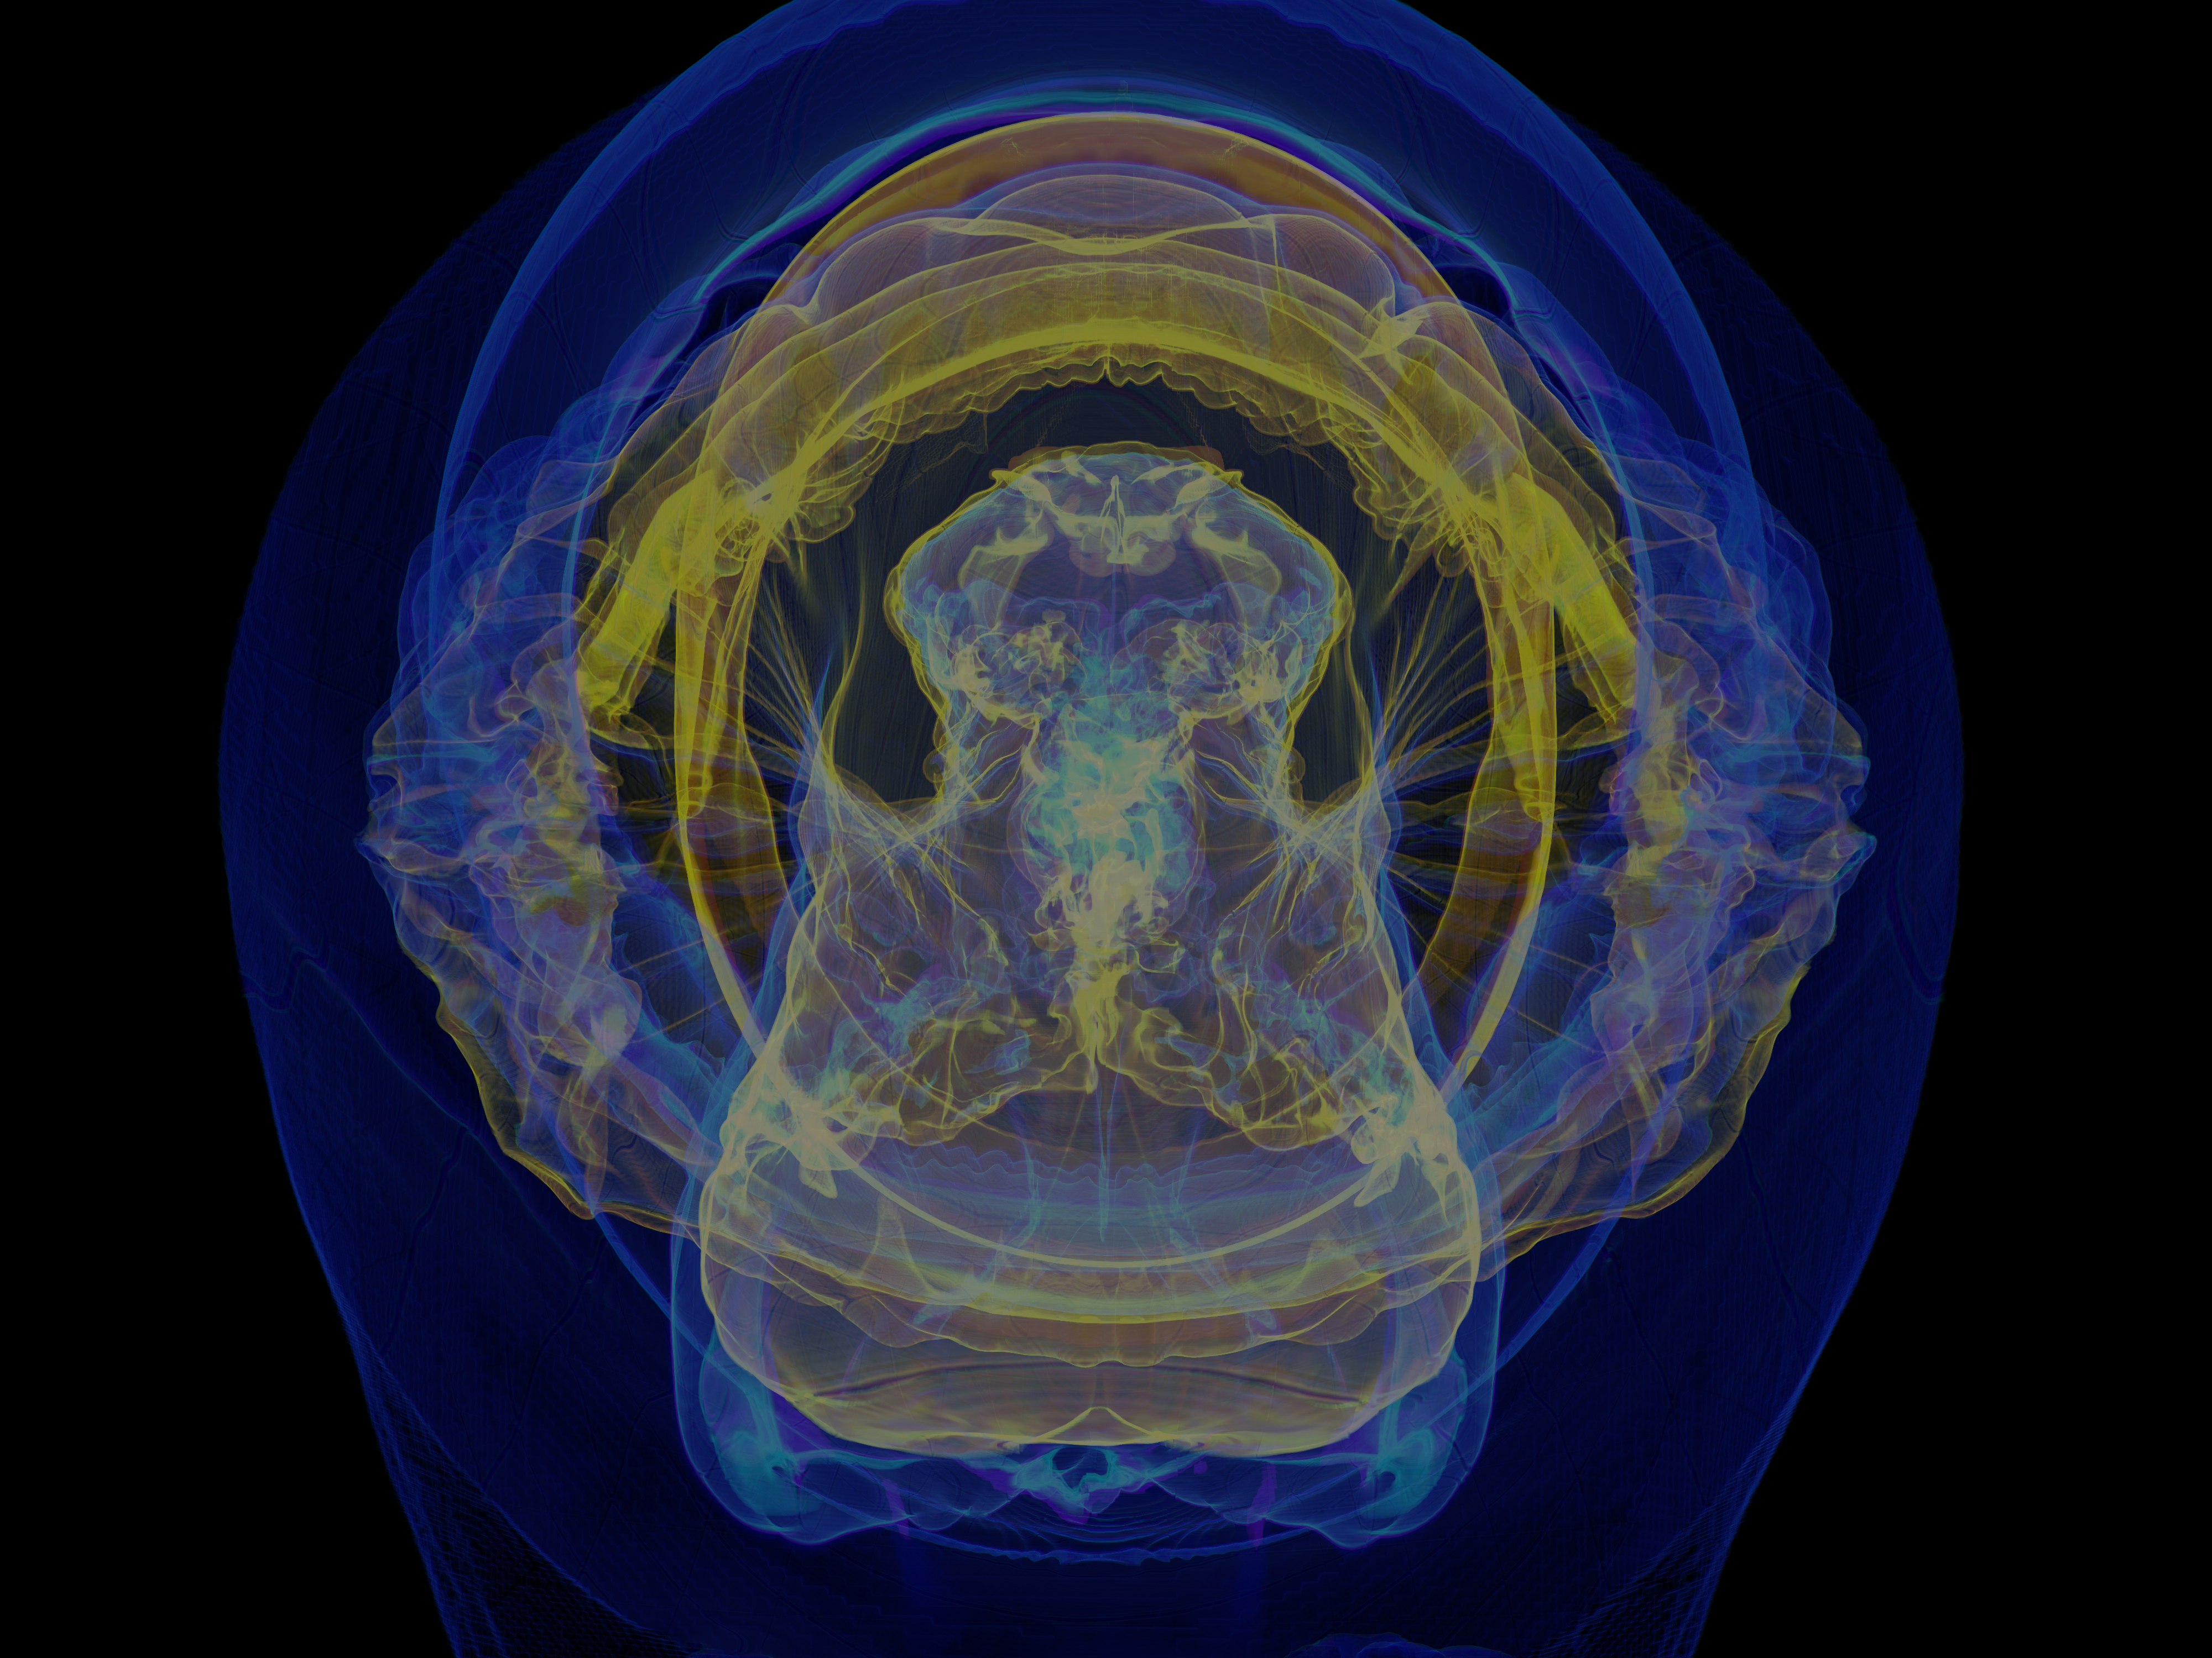
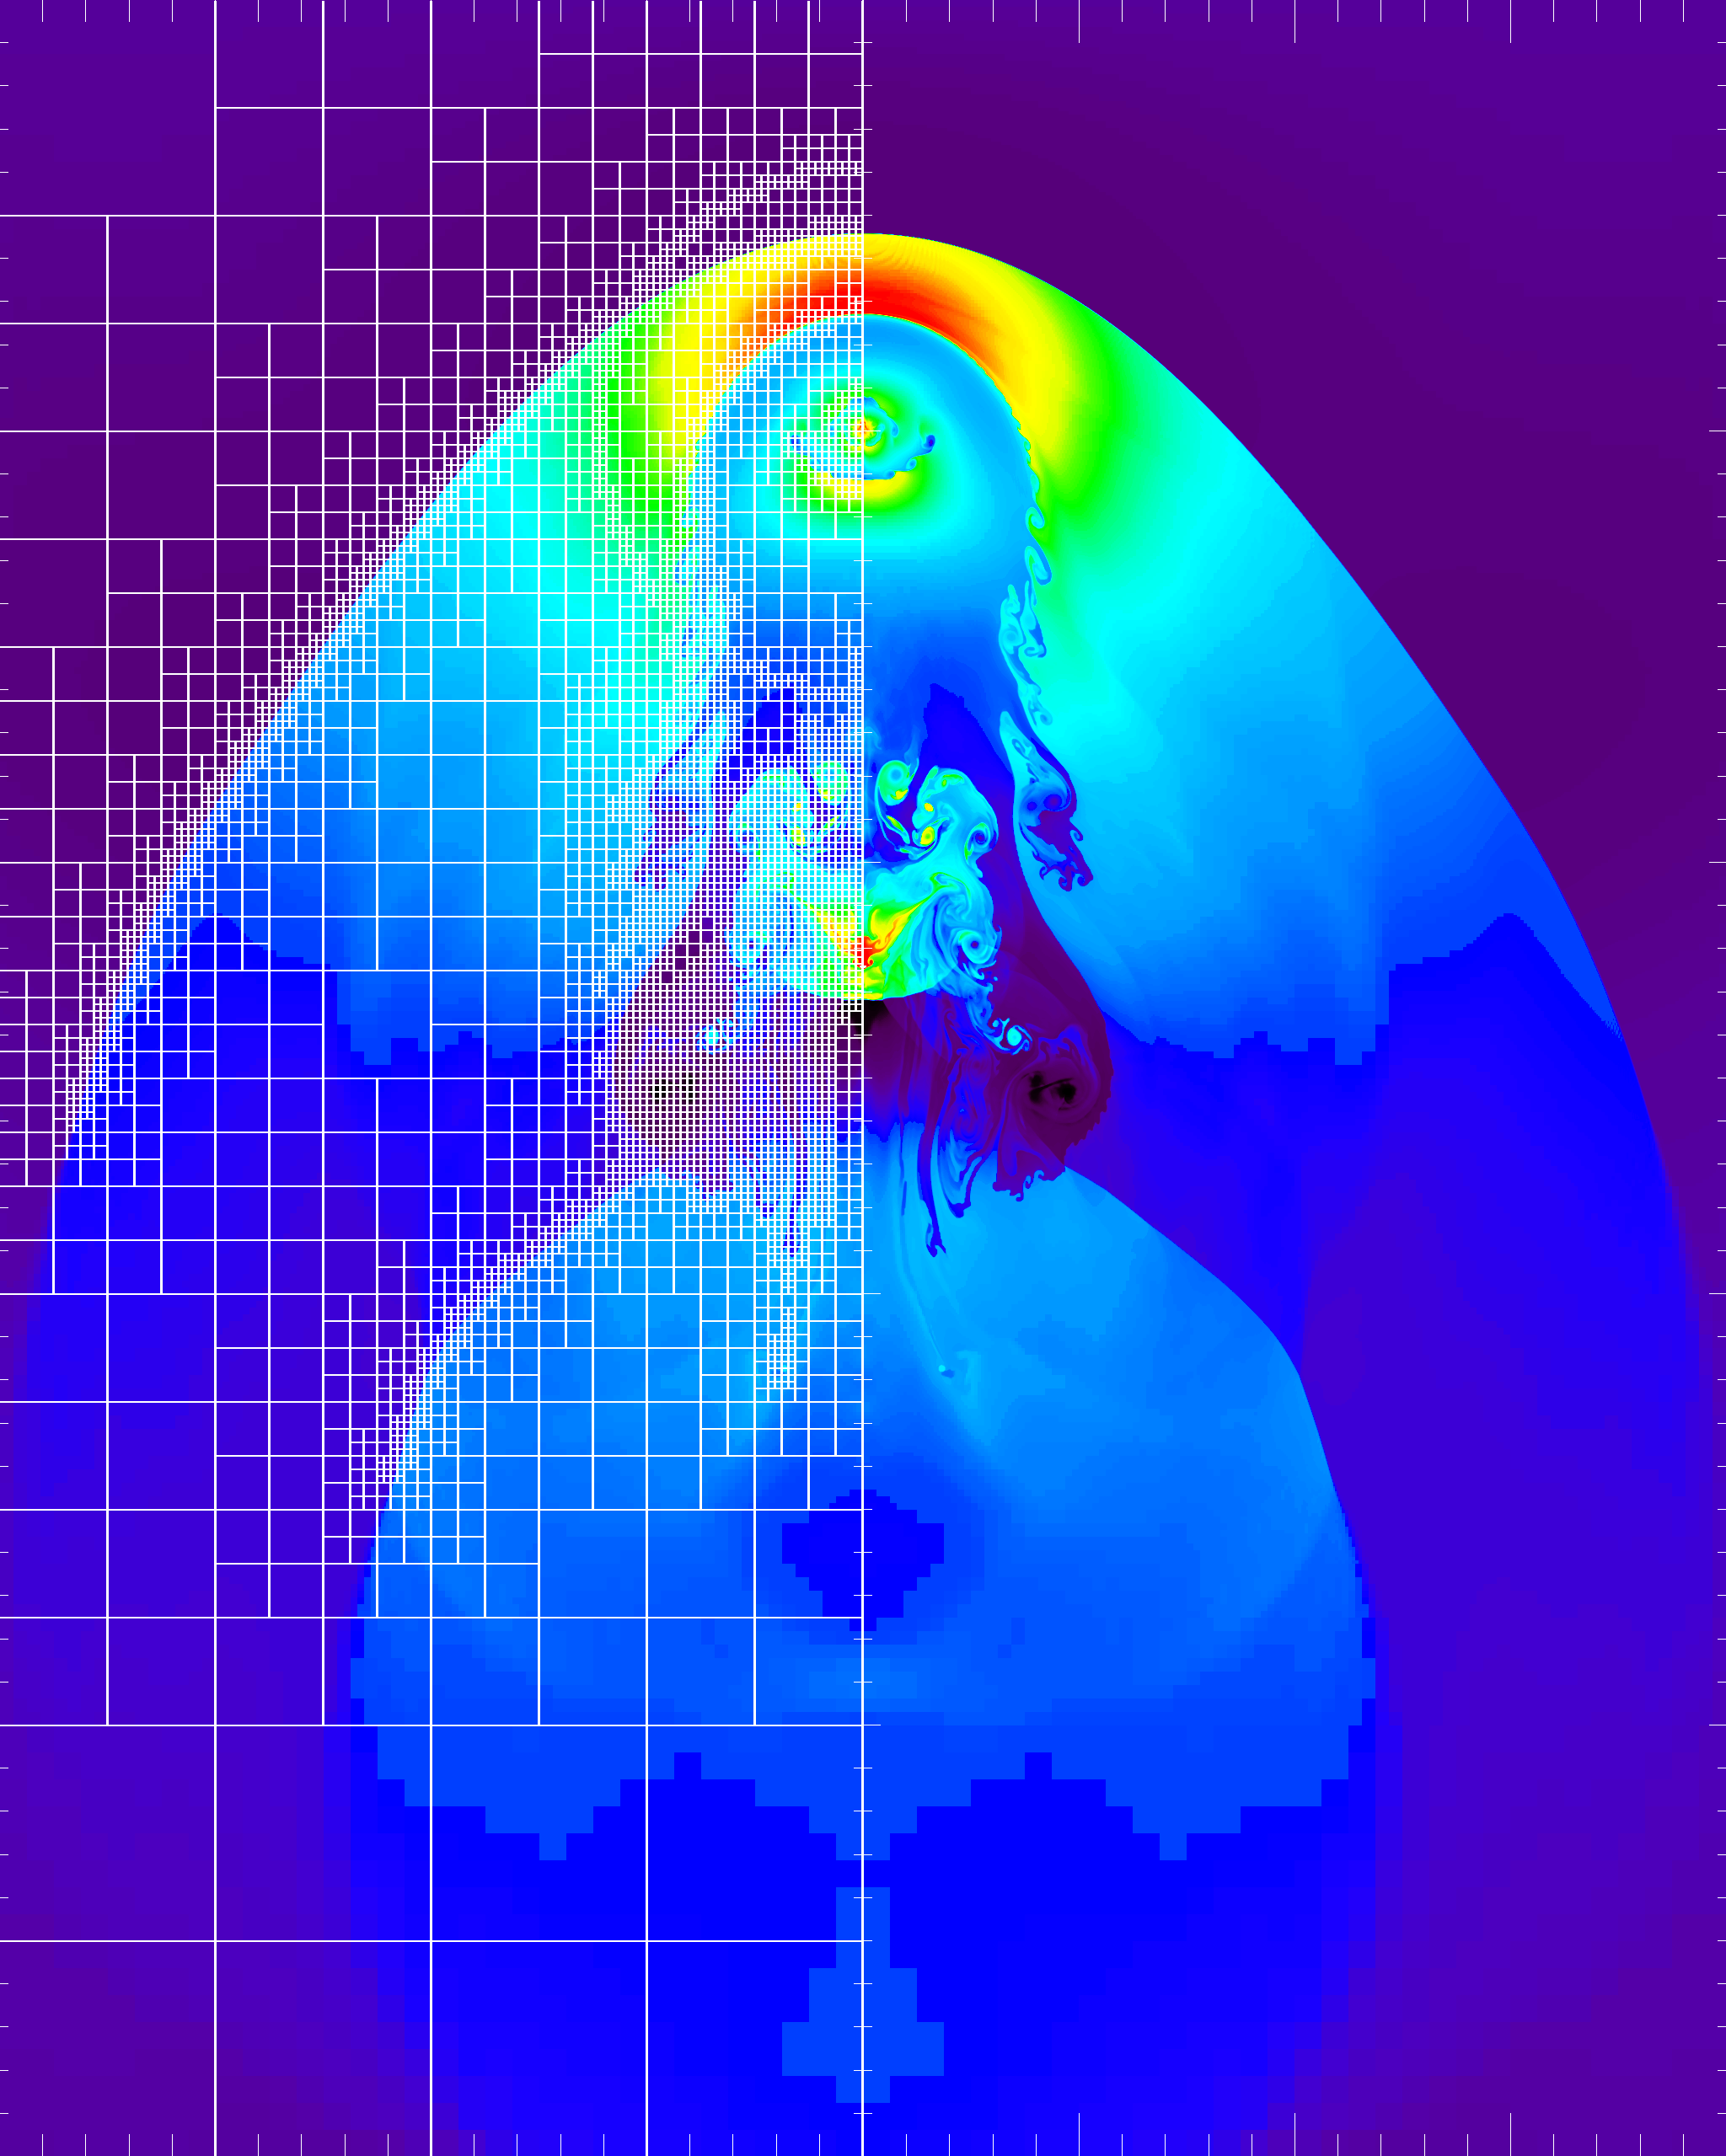
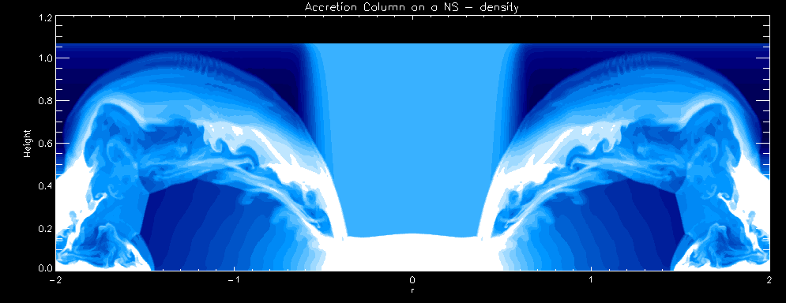
Astrophysics Simulations Need Multi-physics and Multi-scale
Mesh methods: Explicit (gas dynamics), semi-Implicit (gravitational potential), and implicit (radiation)
Particle methods: tracers, massive, charged
Point-wise calculations: EOS, source terms
AMR for data and computation compression
Type !a Supernova
Gravitational collapse/Jeans instability
Galaxy Cluster Merger
Intracluster interactions
Developing and maintaining such complex codes is beyond the resources of capabilities of individuals or even small groups: Community codes are the solution
Shortly: Relativistic accretion onto NS

Slide 7
What About Other Communities ?
Community/open-source approach more common in areas which need multi-physics and/or multi-scale
A visionary sees the benefit of software re-use and releases the code
Sophistication in modeling advances more rapidly in such communities
Others keep their software close for perceived competitive advantage
Repeated re-invention of wheel
General advancement of model fidelity slower
Let us examine what does it take to build a community code

Slide 8
“Cathedral and the Bazaar”, Eric S. Raymond
The Cathedral model
Code is available with each software release
Development between releases is restricted to an exclusive group of software developers.
GNU Emacs and GCC are presented as examples.
Central control models
The Bazaar model
Code is developed over the Internet in view of the public.
Raymond credits Linus Torvalds, leader of the Linux kernel project, as the inventor of this process.
Distributed control models

Slide 9
Scientific codes
Mostly follow the cathedral model
Many reasons are given, some valid, others spring from bias
The valid ones
Scientists tend to be skeptical of software engineering
The code quality becomes hard to maintain
Hard to find financial support for gate keeping and general maintenance
Typical user communities are too small to effectively support the bazaar model
The reward structure for majority of potential contributors is incompatible
The not so valid ones
Codes are far too complex
Competitive advantage from owning the code
The real reason many times is simply the history of the development of the code
and the pride of ownership

Slide 10
Scientific Community Codes Can Follow Several Different Paths :
The most common path
Someone wrote a very useful piece of code that several people in the group started using
Collaborations happened
People moved and took the code with them
Critical mass of users achieved, code becomes popular
No focused effort to build the code
Usually very little software process involved
For the whole code, limited shelf life

Slide 11
A More Sustained Path
Sometimes enough like minded people take it a step further
Some long term planning might result in better engineered code
Thought given to extensibility and for future code growth
As the code grows so does its community supported model
This model is still relatively rare.
The occurrences are increasing

Slide 12
A Desirable Path
Explicit funding to build a code for a target community
Implied support for the design phase
The outcome is expected to be long lasting and well engineered
The occurrences are even rarer
And it is getting increasingly harder
When it works outcome is more capable and longer lasting codes

Slide 13
Open Source Benefits
Nobody can pull the plug
Users have the source code, free to use and modify, in perpetuity.
Users don’t have to pay
They pay with their time and attention and what they give back.
Stakeholders are power
Not all stakeholders are equivalent
User count may not be as helpful as vocal collaborators

Slide 14
Software Engineering and Process
Strong interfaces and encapsulation (enforced by the language or build system) enables community participation.
Users can customize in many different ways
Depends somewhat on the code architecture
Add needed interfaces on top of infrastructure
Use derived classes
Open-source means they can control customization

Slide 15
The Benefits of the Bazaar model
Given a large enough beta-tester and co-developer base, almost every problem will be characterized quickly and the fix will be obvious to someone
More varied test cases that demonstrate bugs
Debugging can be effectively parallelized.
The infrastructure limitations are quickly exposed
Capability addition is rapid, codes can do more
A corollary to that is a good extensible design
Users always want something more and/or something different from what is available
Greater knowledge pool operating together, more possibility of innovation

Slide 16
The Pitfalls of the Bazaar model
Many of the benefitting reasons can equally easily go the other way
Bigger knowledge pool can also mean more conflicting opinions
Prioritizations can become extremely challenging
Gatekeeping can become a huge challenge for maintaining software quality
Scientific codes have their own peculiarities for verification and validation that can be extremely challenging
The orchestration of capability combination is harder when there is physics involved because many times it just won’t play well together

Slide 17
Other Considerations : User Expertise
Novice users – execute one of included applications
change only the runtime parameters
Most users – generate new problems, analyze
Generate new Simulations with initial conditions, parameters
Write alternate and/or derived functions for specialized output
Advanced users – Customize existing functions
Add small amounts of new code needed by their application
Expert – new research
Completely new algorithms and/or capabilities
Can contribute to core functionality

Slide 18
Distribution Policies
The licensing agreement
How restrictive ?
Distribution control
Who can get the code
Should there be a registration requirement
What is included in the release
The degree of support for released components
How often to release
Trade-off between making capabilities available quickly and the overhead of releasing

Slide 19
Contribution Policies
Balancing contributors and code distribution needs
Contributors want their code to become integrated with the code so it is maintained, but may not want it released immediately
Not exercised enough
Contributor may want some IP protection
Maintainable code requirements
The minimum set needed from the contributor
Source code, build scripts, tests, documentation
Agreement on user support
Contributor or the distributor
Add-ons : components not included with the distribution, but work with the code

Slide 20
Community Building
Popularizing the code alone does not build a community
Neither does customizability – different users want different capabilities
So what does it take ?
Enabling contributions from users and providing support for them
Including policy provisions for balancing the IP protection with open source needs
Relaxed distribution policies – giving collective ownership to groups of users so they can modify the code and share among themselves as long as they have the license
More inclusivity => greater success in community building
An investment in robust and extensible infrastructure, and a strong
culture of user support is a pre-requisite

Slide 21
Examples : FLASH Developed and Distributed by One Institution
Under sustained funding from the ASC alliance program
One of the expected outcomes was a public code
Use the same code for many different applications
All target applications were for reactive flows
Diverging camps from the beginning
Camp 1: Produce a well architected modular code
Camp 2: Let’s build what can be used for science soon
Both goals hard to meet in the near term
Two parallel development paths started
Not enough resources to sustain both
Camp 2 won out
Took three iterations of code refactoring to get robust framework built

Slide 22
FLASH’s Community
Originally designed for thermo-nuclear flashes
Expanded to include N-body capabilities through particles
Over the years many other physics capabilities got added
Now serves many communities in Astrophysics, and also serves HEDP and CFD/FSI
Most rapid increase in modeling laser experiments
Only open code for the community
Very little modification to the basic infrastructure needed to accommodate these capabilities
Additions typically prove to be synergistic for all the communities

Slide 23
Some Statistics
Releases roughly every 6-8 months
In version 4.x now
More than 850 papers have used it for obtaining results
Increasingly more sophisticated contributions from outside the core group
Sink particles
Incompressible Navier-Stokes solver
Primordial Chemistry

Slide 24
Community Building
Took several years
Started with collaborations with the Center scientists
Alumni of the center took the culture and the code with them
Their students and post-docs adopted the code
Tutorials on-site and at scientific conferences to promote
Tutorials had hands-on sessions and help for user’s specific problems
Easy customizability built into the infrastructure helped
As did the included ready to run examples
Increasing capabilities enable tackling more complex and higher fidelity modeling
The greatest impact in popularizing the code though was relative ease in getting
started, quick turn-around for user’s questions and hand holding provided through
the mailing lists

Slide 25
Enzo : Transitioned from close to open source
Started as a closed code
From 1996-2003
First public release in March 2004
Mostly cathedral model
Has now moved very close to a bazaar model
25 contributors (~12 active developers) at >10 institutions
~200 people on enzo-users mailing list (~50% active?)
Financial support from NSF (AST, OCI, PHY), NASA,and DOE
Complementary community: yt (http://yt-project.org)

Slide 26
Development Model
Entirely distributed development model
Small number of developers per institution
Use code forks / pull requests to move features from development branches to the main branch
Almost all discussion on archived public mailing lists
And on Google docs

Slide 27
Community
Most developers are astrophysicists “scratching their own itch”
Development spurred by ~1.5 workshops/year
And periodic task-oriented “code sprints”
Many streams of funding
Enthusiastic and heavily involved user/developer community
Challenges:
No leader => hard to make major code revisions
Part-time developers: distractions, less incentive to do “boring but important” infrastructure development
Significant work required to build consensus and keep community together

Slide 28
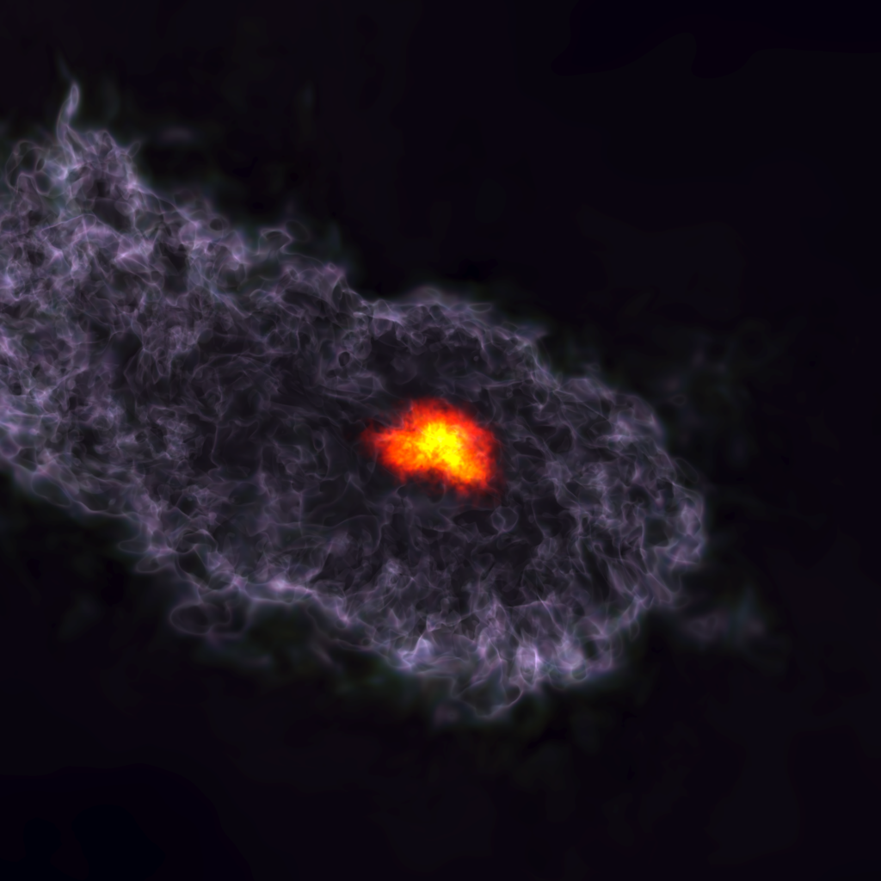
The yt Project
Growing & Engaging a community of practice

Slide 29
Building a community …
The technical and social aspects

Slide 30
Traditional View of Scientific Development
"Users"
"Developers"

Slide 31
Most Scientific Development
"Users"
"Developers"

Slide 32
Community of Practice
"Devusers"

Slide 33
Foster a community of peers,
not a community of elites.

Slide 34
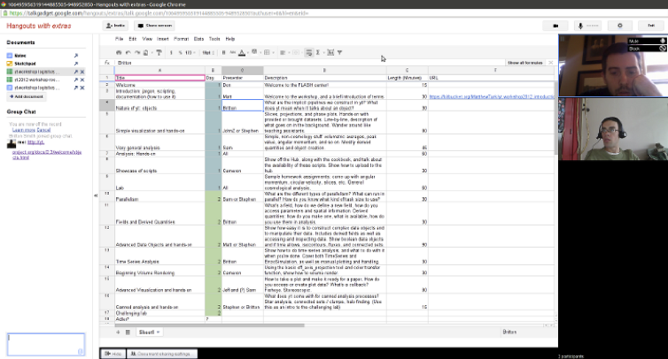
Immediate

Slide 35
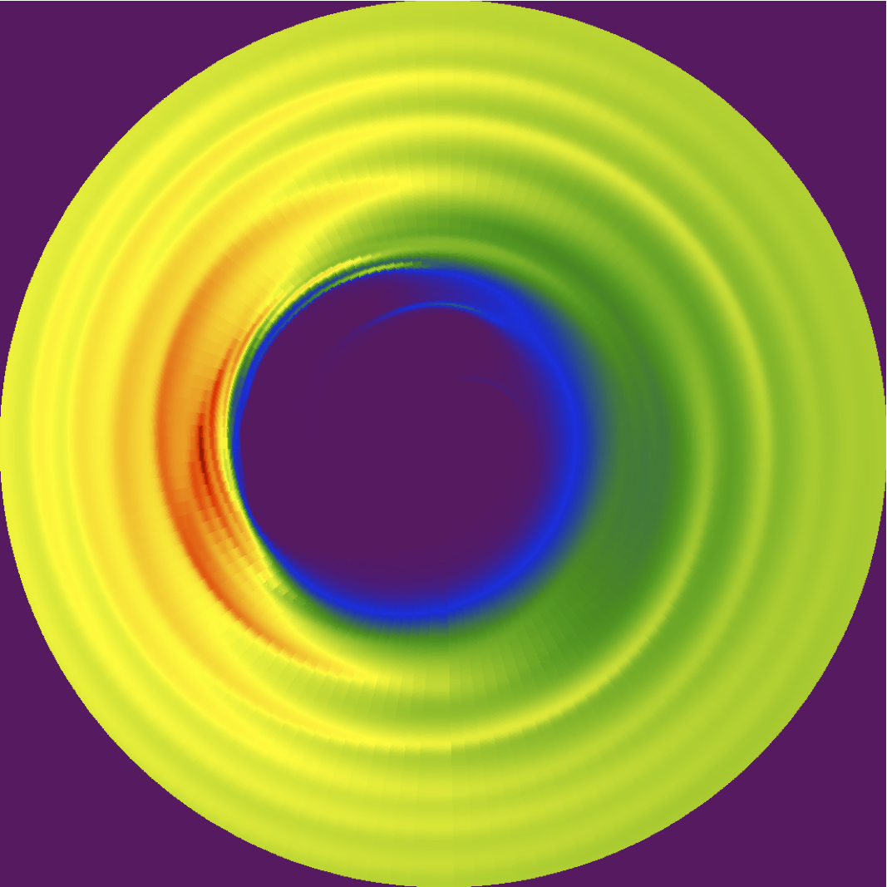
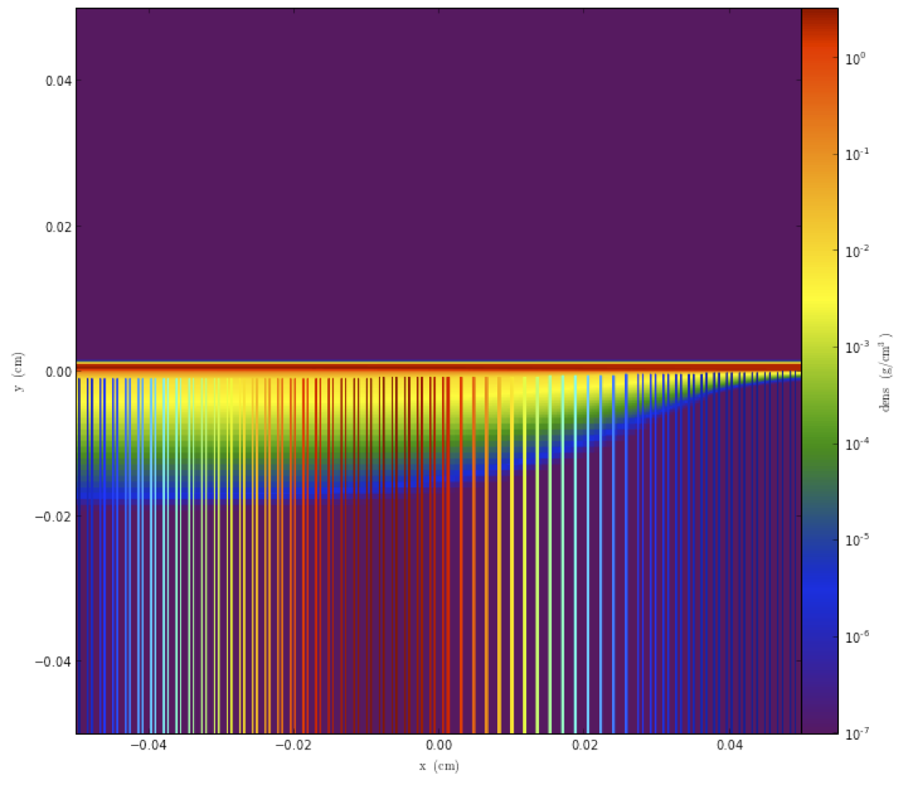
Immediate

Slide 36
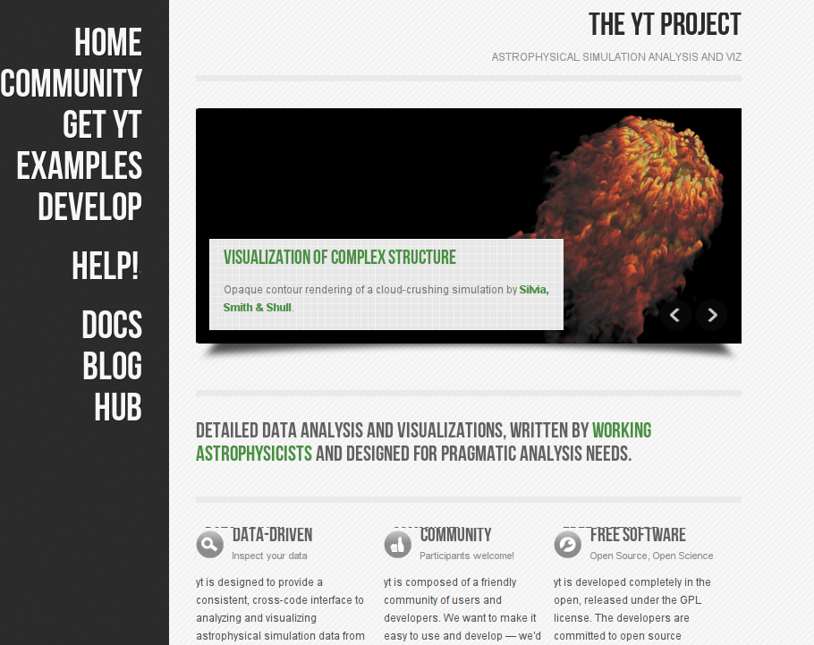

Slide 37
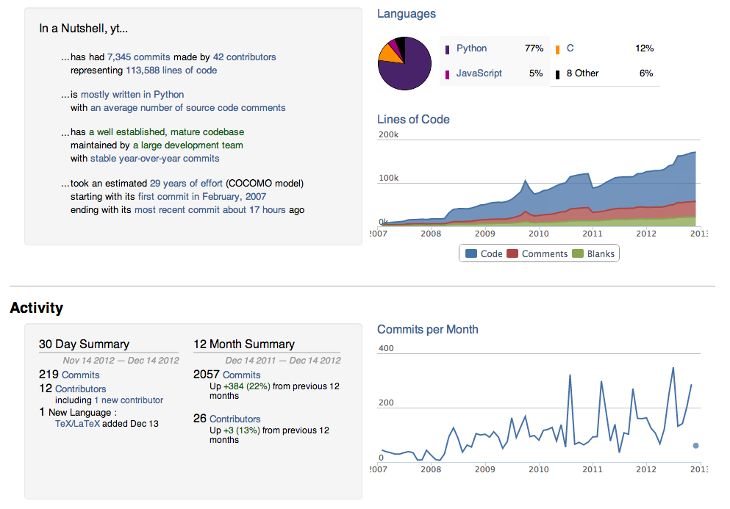

Slide 38
Common Threads
Open source with a governance structure in place
Trust building among teams
Commitment to transparent communications
Strong commitment to user support
Either an interdisciplinary team, or a group of people comfortable with science and code development
Attention to software engineering and documentation
Understanding the benefit of sharing as opposed to being secretive about the code

Slide 39
General Impact
Scientists can focus on developing for their algorithmic needs instead of getting bogged down by the infrastructural development
Graduate students do not start developing codes from scratch
Look at the available public codes and converge on the ones that most meet their needs
Look at the effort of customization for their purposes
Select the public code, and build upon it as they need
Important to remember that they still need to understand the components developed by others that they are using, they just don’t have to actually develop everything themselves. And this is particularly true of pesky detailed infrastructure/solvers that are too well understood to have any research component, but are time consuming to implement right

Slide 40
General Impact
Researchers can build upon work of others and get further faster, instead of reinventing the wheel
Code component re-use
No need to become an expert in every numerical technique
More reliable results because of more stress tested code
Goes back to argument for the bazaar model, enough eyes looking at the code will find any errors faster
New implementations take several years to iron out the bugs and deficiencies
Different users use the code in different ways and stress it in different ways
Open-source science results in more reproducible results
Generally good for the credibility

Slide 41
General Impact
Involvement in this community has strongly affected young scientists’ career trajectories
They have produced more significant and far-reaching advances in their fields
They have understood the importance of rigorous verification and validation in the scientific process
They have learned to use the good software practices to their advantage
Unexpected side benefits:
Arrival of yt spurred the development in Enzo
FLASH morphed into community code for areas that have very little to do with its original target
Took addition of a few physics models and there was a working code in a few months
New developments helped the Astro community

Slide 42
Conclusions
There are many reasons why community codes are good and should be encouraged
Science and engineering by simulation needs more scrutiny into the methods and software
There is no need to keep reinventing the wheel
Starting from scratch for any computational project where implementations exist is a waste
This is especially true of book-keeping work
Scientists aren’t trained to write good maintainable and performant software
Optimization blockers
Spaghetti codes
No rigorous verification program
The Solution : Let the professionals do the software design and engineering with a lot of input from the target user community (ideally some users will also be developers)

Slide 43
Culture self-propagates.
So, it must be seeded directly.

Slide 44
"... it seems likely that signiﬁcant software contributions to existing scientiﬁc software projects are not likely to be rewarded through the traditional reputation economy of science. Together these factors provide a reason to expect the over-production of independent scientiﬁc software packages, and the underproduction of collaborative projects in which later academics build on the work of earlier ones."
Howison & Herbsleb (2011)

